Slide 1
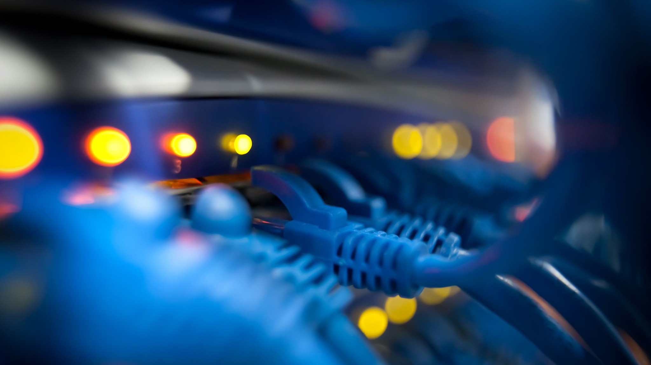
Internet of Things - BLE
Devona Asif - 20014476

Slide 2
Internet of Things (IoT)
First Introduced in 2005 by The International Telecommunication Union (ITU).
“The Internet of Things (IoT) refers to a network of physical devices, vehicles, appliances, and other physical objects that are embedded with sensors, software, and network connectivity, allowing them to collect and share data.” - IBM

Slide 3
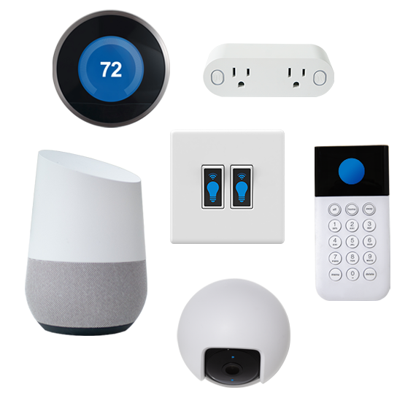
IoT in Everyday Lives
Image Source: digicerti.com

Slide 4
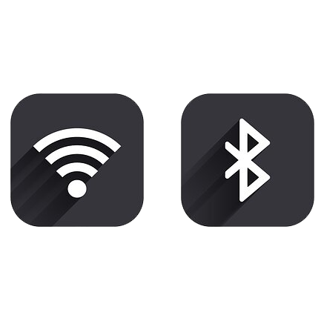
Types of Connectivity Technology
Wi-Fi
Bluetooth Classic
Bluetooth Low Energy (BLE)
Zigbee
Long-Range Wide-Area-Networks (LoRaWAN)
NB-IoT
Z-Wave
Sigfox
RFID
LTE-M.
Image Source: tsfvintageradios.com

Slide 5

History of Bluetooth
Bluetooth technology was named after Viking King Harald “Bluetooth” Gormsson.
“King Harald Bluetooth…was famous for uniting Scandinavia just as we intended to unite the PC and cellular industries with a short-range wireless link.” – Jim Kardach, Intel
Image Source: wikipedia.com

Slide 6
Evolution of Bluetooth
Bluetooth 1.0 (1999)
Bluetooth 2.0 (2004)
Bluetooth 3.0 (2009)
Bluetooth 4.0 (2010)
Bluetooth 5.0 (2016)
Image Source: wikipedia.com

Slide 7
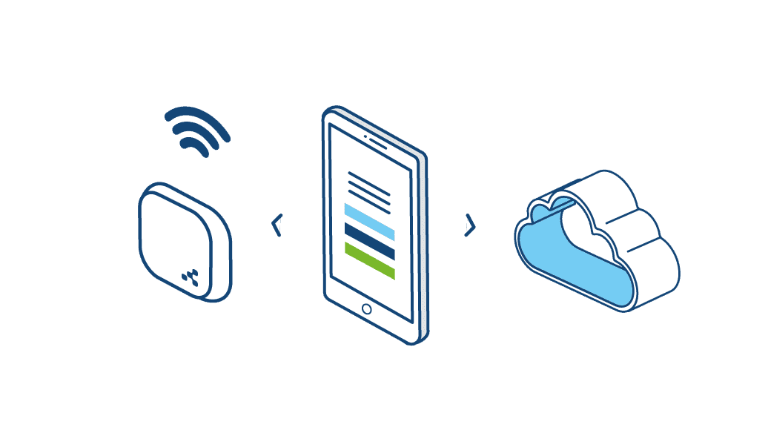
Bluetooth Low Energy (BLE)
In 2010, Bluetooth 4.0 introduced BLE –
Designed for:
low power consumption
long battery life
Cost effectiveness
Image Source: novida.com

Slide 8
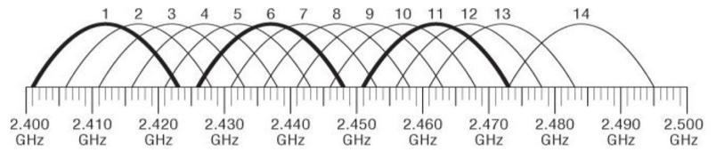
2.4GHz spectrum
BLE uses Gaussian Frequency Shift Keying (GFSK) for modulation and operates on the 2.4 GHz ISM band
The BLE 2.4-GHz spectrum comprises 40 channels, with advertising on channels 37, 38, and 39
Image Source: researchgate.net

Slide 9
Primary Characteristics
BLE's primary characteristics include:
Range: Up to 33 meters in ideal conditions.
Latency: Affected by scan windows, advertising intervals, and scan intervals.
Power Consumption: Devices can operate on small batteries for extended periods.
Image Source: novida.com

Slide 10
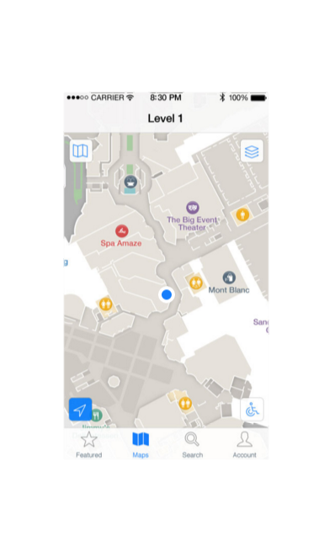
Application of BLE
Some of the many applications include:
Beacon technology
Mobile payments
Context-aware notifications
Image Source: mobile72.com

Slide 11
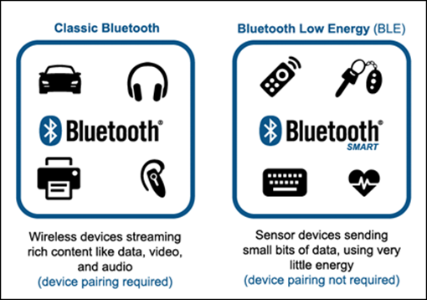
Classic Bluetooth vs BLE
Image Source: onetemp.com.au

Slide 12

BLE Beacons
BLE beacons broadcast messages to nearby devices enabling geolocation services, promotions, and seamless transactions.
Popular BLE beacon profiles include:
Apple’s iBeacon
Google’s Eddystone
Image Source: developer.apple.com

Slide 13
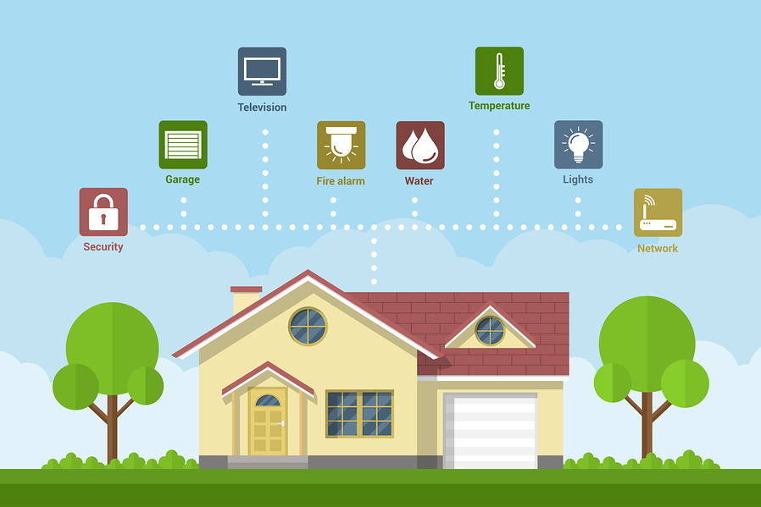
IoT’s Adaptation of BLE
IoT applications
Driving innovations
Indoor tracking
Energy-efficient businesses
Smart home management
Image Source: developex.com

Slide 14
Challenges in BLE
Unsafe pairing methods
Protocol compatibility
Limited battery life
System scaling issues
Unreliable signals in packed situations
Excessive network requests cause scalability issues

Slide 15
BLE Security Issues
Security can be a concern with BLE. Due to restricted device resources, lightweight cryptography algorithms are required. The three major security problems are:
Mobility
Wireless vulnerabilities
Scalability

Slide 16
BLE vs LoRaWAN
BLE:
Ideal for short range
Low power applications
LoRaWAN:
Handles device connections in a star topology
Ideal for long-range
Large scale deployments

Slide 17
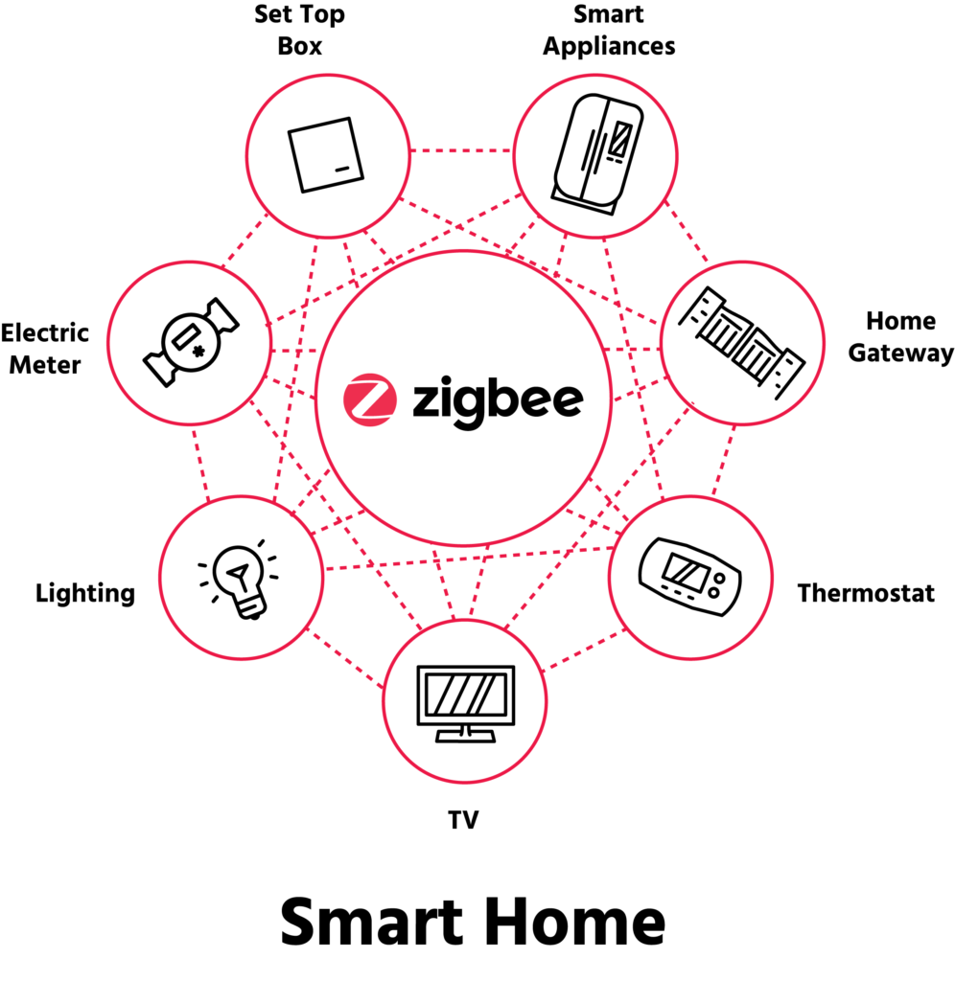
BLE vs Zigbee
Image Source: csa-iot.org

Slide 18
BLE in Vehicles
In-Vehicle Wireless Sensor Networks (IVWSNs):
BLE investigated for IVWSNs in public transportation, particularly buses
Study shows BLE's potential to replace traditional wired networks, reducing complexity and cost
Bluetooth 5's mesh topology provides efficient, adaptable solutions for large-scale vehicle networks

Slide 19
Future of BLE in IoT
Ongoing Advancements:
Continuous improvements in range, speed, and efficiency
Future developments expected to address current challenges like security and range limitations
Comparison with Other Technologies:
BLE provides a balanced solution for short-range, energy-efficient applications
Complements other technologies like LoRaWAN and Wi-Fi for specific IoT needs
Image Source: wikipedia.com

Slide 20
Conclusion
Critical Role in IoT:
BLE balances power efficiency and communication range
Essential for various IoT applications due to its low energy consumption and cost-effectiveness
Looking Forward:
Expected to remain a key technology in the evolving IoT landscape
Further research and development will enhance its capabilities and address security concerns
Image Source: wikipedia.com

